Slide 1


Computer-Aided Design FSM Implementation
Mahdi Aminian
Some slides courtesy of:
“Hardware Systems Modeling”, A. Vachoux, EPFL
CAD slides from Dr. Saheb Zamani

Slide 2
FSM
FSM ?
FSM Design ?
FSM Implementation ?

Slide 3
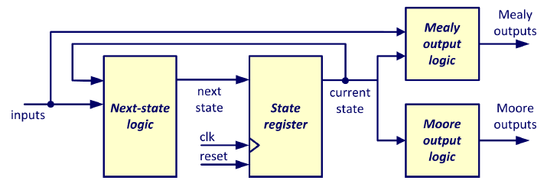
Finite State Machines & VHDL
One- , two- or three-processes
State Encoding
FSM Types
Medvedev
Moore
Mealy
Registered Output

Slide 4

Enumeration Types
architecture EXAMPLE of ENUMERATION is type T_STATE is (RESET, START, EXECUTE, FINISH); signal CURRENT_STATE, NEXT_STATE : T_STATE ; signal TWO_BIT_VEC : bit_vector(1 downto 0); begin -- valid signal assignments NEXT_STATE <= CURRENT_STATE; CURRENT_STATE <= RESET; -- invalid signal assignments CURRENT_STATE <= "00"; CURRENT_STATE <= TWO_BIT_VEC; end EXAMPLE;
Designers may define their own types
enhanced readability (commonly used to describe the states of a state machine)
limited legal values
Synthesis tools map enumerations onto a suitable bit pattern automatically.

Slide 5
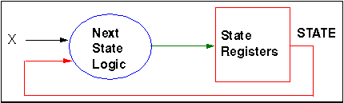
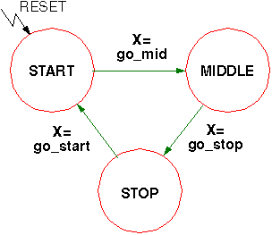
One-Process FSM
FSM_FF: process (CLK, RESET) begin if RESET='1' then STATE <= START ; elsif CLK'event and CLK='1' then case STATE is when START => if X=GO_MID then STATE <= MIDDLE ; end if ; when MIDDLE => if X=GO_STOP then STATE <= STOP ; end if ; when STOP => if X=GO_START then STATE <= START ; end if ; when others => STATE <= START ; end case ; end if ; end process FSM_FF ;

Slide 6
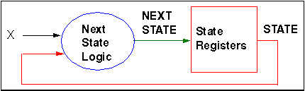
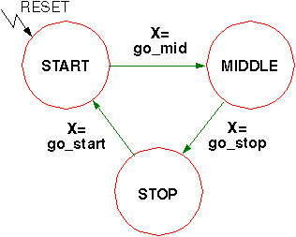
Two-Process FSM
FSM_LOGIC: process ( STATE , X) begin case STATE is when START => if X=GO_MID then NEXT_STATE <= MIDDLE ; end if ; when MIDDLE => ... when others => NEXT_STATE <= START ; end case ; end process FSM_LOGIC ;
FSM_FF: process (CLK, RESET) begin if RESET='1' then STATE <= START ; elsif CLK'event and CLK='1' then STATE <= NEXT_STATE ; end if; end process FSM_FF ;

Slide 7
How Many Processes?
Structure and Readability
Asynchronous combinatory, synchronous storing elements => 2 processes
Graphical FSM (without output equations) resembles one state process => 1 process
Simulation
Error detection easier with two state processes due to access to intermediate signals. => 2 processes
Synthesis
2 state processes can lead to smaller generic net list and therefore to better synthesis results (depends on synthesizer but in general, it is closer to hardware) => 2 processes

Slide 8
State Encoding
type STATE_TYPE is ( START, MIDDLE, STOP ) ; signal STATE : STATE_TYPE ;
State encoding responsible for safety of FSM
START -> " 00 " MIDDLE -> " 01 " STOP -> " 10 "
Default encoding: binary
START -> " 001 " MIDDLE -> " 010 " STOP -> " 100 "
Speed optimized default encoding: one hot
Note: unsafe FSM!

Slide 9
Encoding of CASE Statement
type STATE_TYPE is (START, MIDDLE, STOP) ; signal STATE : STATE_TYPE ; · · · case STATE is when START => · · · when MIDDLE => · · · when STOP => · · · when others => · · · end case ;
Adding the "when others" choice
Not necessarily safe; some synthesis tools will ignore "when others" choice

Slide 10

Extension of Type Declaration
type STATE_TYPE is (START, MIDDLE, STOP, DUMMY) ; signal STATE : STATE_TYPE ; ··· case STATE is when START => ··· when MIDDLE => ··· when STOP => ··· when DUMMY => ··· -- or when others end case ;
Adding dummy values
Only for binary encoding
Advantages:
Safe FSM after synthesis
{2 ^{⎡log2(# of states)⎤} - n} dummy states (n=20 => 12 dummy states)
Changing to one hot coding => unnecessary hardware (n=20 => 12 unnecessary Flip Flops)

Slide 11
Hand Coding
subtype STATE_TYPE is std_ulogic_vector (1 downto 0) ; signal STATE : STATE_TYPE ; constant START : STATE_TYPE := "01"; constant MIDDLE : STATE_TYPE := "11"; constant STOP : STATE_TYPE := "00"; ··· case STATE is when START => ··· when MIDDLE => ··· when STOP => ··· when others => ··· end case ;
Defining constants
Control of encoding
Safe FSM
Portable design
Disadvantage:
More effort (especially when design changes)

Slide 12
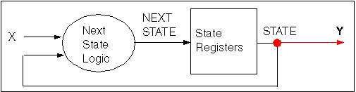
FSM: Medvedev
Two Processes
architecture RTL of MEDVEDEV is ... begin REG: process (CLK, RESET) begin -- State Registers Inference end process REG ; CMB: process (X, STATE) begin -- Next State Logic end process CMB ; Y <= S ; end RTL ;
The output vector resembles the state vector: Y = S
One Process
architecture RTL of MEDVEDEV is ... begin REG: process (CLK, RESET) begin -- State Registers Inference with Logic Block end process REG ; Y <= S ; end RTL ;

Slide 13
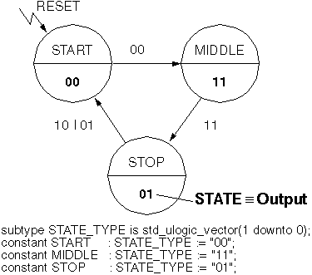
Medvedev Example (2-Process)
CMB: process (A,B,STATE) begin case STATE is when START => if (A or B)='0' then NEXTSTATE <= MIDDLE ; end if ; when MIDDLE => if (A and B)='1' then NEXTSTATE <= STOP ; end if ; when STOP => if (A xor B)='1' then NEXTSTATE <= START ; end if ; when others => NEXTSTATE <= START ; end case ; end process CMB ; -- concurrent signal assignments for output (Y,Z) <= STATE ; end RTL ;
architecture RTL of MEDVEDEV_TEST is signal STATE,NEXTSTATE : STATE_TYPE ; begin REG: process (CLK, RESET) begin if RESET='1' then STATE <= START ; elsif CLK'event and CLK='1' then STATE <= NEXTSTATE ; end if ; end process REG;

Slide 14
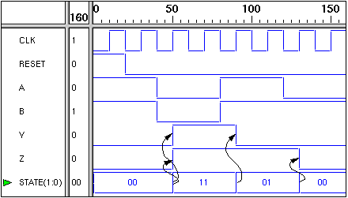
Medvedev Example Waveform
(Y,Z) = STATE => Medvedev machine

Slide 15
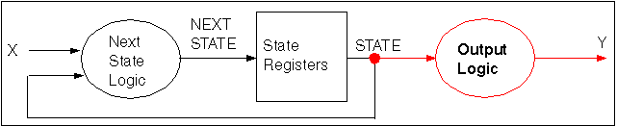
FSM: Moore
The output vector is a function of the state vector: Y = f(S)
Two Processes
architecture RTL of MOORE is ... begin REG: process (CLK, RESET) begin -- State Registers Inference with Next State Logic end process REG ; OUTPUT: process (STATE) begin -- Output Logic end process OUTPUT ; end RTL ;
Three Processes
architecture RTL of MOORE is ... begin REG: -- Clocked Process CMB: -- Combinational Process OUTPUT: process (STATE) begin -- Output Logic end process OUTPUT ; end RTL ;

Slide 16
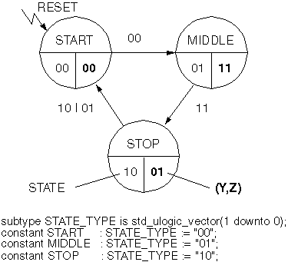
Moore Example
Since outputs depend only on the current state, no signals other than STATE appears in the sensitivity list.
CMB: process (A,B,STATE) begin case STATE is when START => if (A or B)='0' then NEXTSTATE <= MIDDLE ; end if ; when MIDDLE => if (A and B)='1' then NEXTSTATE <= STOP ; end if ; when STOP => if (A xor B)='1' then NEXTSTATE <= START ; end if ; when others => NEXTSTATE <= START ; end case ; end process CMB ; -- concurrent signal assignments for output Y <= ‘1’ when STATE=MIDDLE else ‘0’ ; Z <= ‘1’ when STATE=MIDDLE or STATE=STOP else ‘0’; end RTL ;
architecture RTL of MOORE_TEST is signal STATE,NEXTSTATE : STATE_TYPE ; begin REG: process (CLK, RESET) begin if RESET='1' then STATE <= START ; elsif CLK'event and CLK='1' then STATE <= NEXTSTATE ; end if ;
end process REG ;

Slide 17
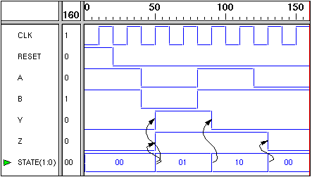
Moore Example Waveform
(Y,Z) changes simultaneously with STATE → Moore machine

Slide 18
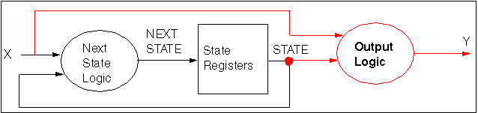
FSM: Mealy
The output vector is a function of the state vector and the input vector: Y = f(X,S)
Two Processes
architecture RTL of MEALY is ... begin MED: process (CLK, RESET) begin -- State Registers Inference with Next State Logic end process MED ; OUTPUT: process (STATE, X) begin -- Output Logic end process OUTPUT ; end RTL ;
Three Processes
architecture RTL of MEALY is ... begin REG: -- Clocked Process CMB: -- Combinational Process OUTPUT: process (STATE, X) begin -- Output Logic end process OUTPUT ; end RTL ;

Slide 19
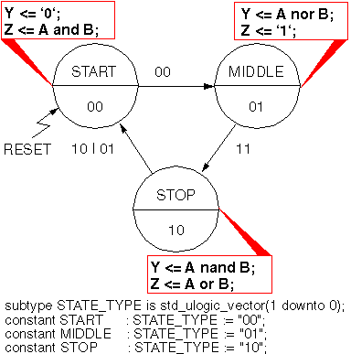
Mealy Example
REG: · · · -- clocked STATE process CMB: · · · -- Like Medvedev and Moore Examples OUTPUT: process (STATE, A, B) begin case STATE is when START => Y <= '0' ; Z <= A and B ; when MIDLLE => Y <= A nor B ; Z <= '1' ; when STOP => Y <= A nand B ; Z <= A or B ; when others => Y <= '0' ; Z <= '0' ; end case; end process OUTPUT; end RTL ;
architecture RTL of MEALY_TEST is signal STATE,NEXTSTATE : STATE_TYPE ; begin

Slide 20
Mealy Example (Another Code)
REG: · · · -- clocked STATE process CMB: · · · -- Like Medvedev and Moore Examples -- Concurrent signal assignments for outputs
Y <= ‘1’
when (STATE = MIDDLE and (A or B) = ‘0’)
or
(STATE = STOP and (A and B) = ‘0’)
else ‘0’; Z <= ‘1’
when (STATE = START and (A and B) = ‘1’)
or (STATE = MIDDLE) or
(STATE = STOP and (A or B) = ‘1’)
else ‘0’; end RTL ;
architecture RTL of MEALY_TEST is signal STATE,NEXTSTATE : STATE_TYPE ; begin

Slide 21
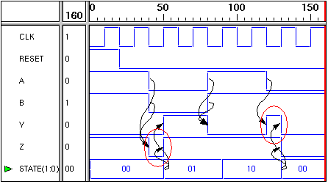
Mealy Example Waveform
(Y,Z) changes with input => Mealy machine
Note the "spikes" of Y and Z in the waveform

Slide 22
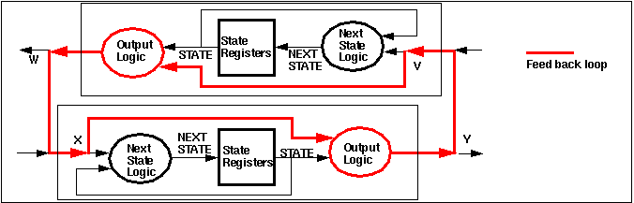
Modeling Aspects
Medvedev is too inflexible
but less hardware (no combinational circuit for output)
More effort to calculate state vector.
Moore is preferred because of safe operation
since o/p depends only on state vector.
→ next output values are stable long before the next clock edge.
Mealy more flexible, but danger of
Spikes
Unnecessary long paths (maximum clock period)
Combinational feed back loops

Slide 23
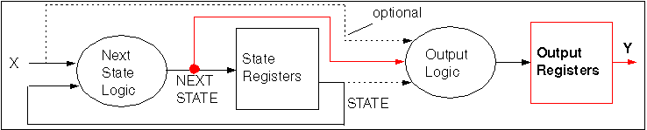
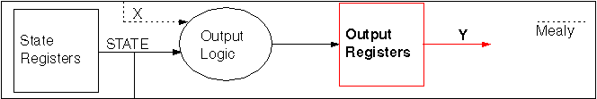
Registered Output
Avoiding long paths and combinational loops.
With one additional clock period
Without additional clock period

Slide 24
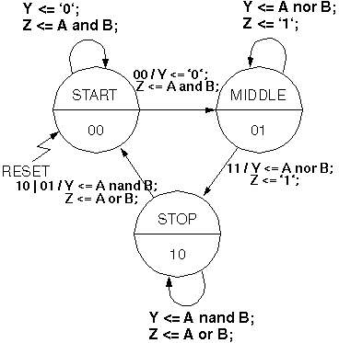
Registered Output Example (1)
REG: · · · -- clocked STATE process CMB: · · · -- Like other Examples OUTPUT: process (STATE, A, B) begin case STATE is when START => Y_I<= '0' ; Z_I<= A and B ; · · · end process OUTPUT -- clocked output process OUTPUT_REG: process(CLK) begin if CLK'event and CLK='1' then Y <= Y_I ; Z <= Z_I ; end if ; end process OUTPUT_REG ; end RTL ;
architecture RTL of REG_TEST is signal Y_I , Z_I : std_ulogic ; signal STATE,NEXTSTATE : STATE_TYPE ; begin

Slide 25
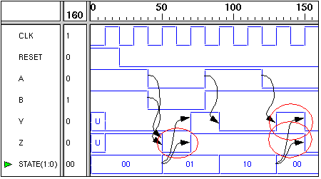
Reg. Output Example Waveform
One clock period delay between STATE and output changes.
Input changes with clock edge result in an output change. (Danger of unmeant values )

Slide 26
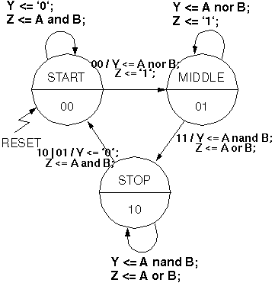
Registered Output Example (2)
REG: · · · -- clocked STATE process CMB: · · · -- Like other Examples OUTPUT: process ( NEXTSTATE , A, B) begin case NEXTSTATE is when START => Y_I<= '0' ; Z_I<= A and B ; · · · end process OUTPUT OUTPUT_REG: process(CLK) begin if CLK'event and CLK='1' then Y <= Y_I ; Z <= Z_I ; end if ; end process OUTPUT_REG ; end RTL ;
architecture RTL of REG_TEST2 is signal Y_I , Z_I : std_ulogic ; signal STATE,NEXTSTATE : STATE_TYPE ; begin

Slide 27
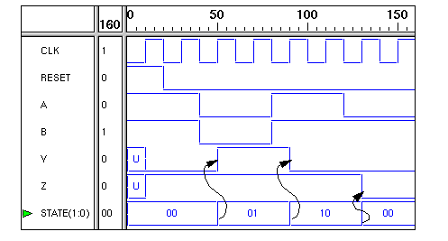
Reg. Output Example Waveform
No delay between STATE and output changes.
"Spikes" of original Mealy machine are gone!

